Slide 1
Bacchus Case study
Jonathan Davis
Madisyn kovacic
Deena linehan
Giancarlo ruiz
Jarred santos
Caleb stark

Slide 2
Bacchus case study
Stan and Davis Bacchus inherited Bacchus Winery from their father three years ago and aim to modernize the business. They retained existing staff: Janet Collins (finance), Roz Murphy (marketing, with assistant Bob Ulrich), Henry Doyle (production manager, overseeing 20 employees), and Maria Costanza (distribution).
The winery produces Merlot, Cabernet, Chablis, and Chardonnay, with supplies from three main suppliers. Stan and Davis want a more efficient inventory and ordering system, possibly online, and Maria seeks online ordering and shipment tracking for distributors.
With their annual review approaching, they need to assess supplier punctuality, wine sales, distributor performance, and employee work hours over the past year.

Slide 3
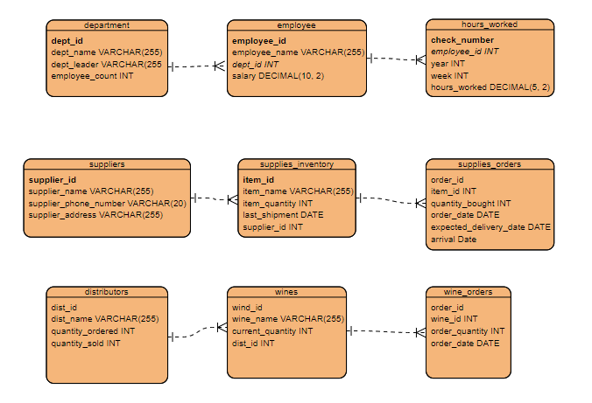
Finalized erd

Slide 4
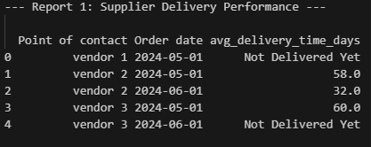
Supplier delivery performance
This report displays supplier delivery performance by showing order dates and average delivery time per point of contact. This system allows both vendors and suppliers to track processes as desired by Maria. It also facilitates creating a yearly snapshot, providing Stan and Davis with their desired information to easily flag orders that are taking longer.

Slide 5
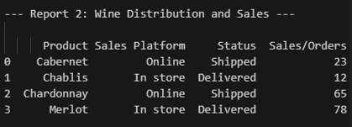
Wine distribution and sales
In addition to Report One, Report Two enables easy tracking by product, sales platform, status, and sales/orders. This provides Bacchus Winery with a detailed tracking source, showing where sales are most likely, which wines are selling best, and allowing in-house tracking of distribution status. This supports Stan and Davis's goal for a comprehensive yearly snapshot.

Slide 6
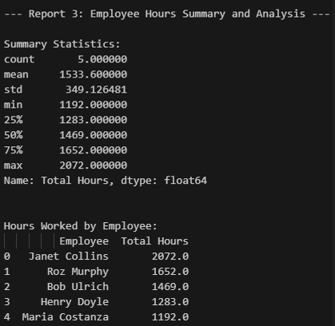
Employee hours summary and analysis
Report Three enhances the information available to Stan and Davis for their yearly snapshot by enabling tracking of employee hours. By breaking down employee hour statistics, they can identify full-time and part-time work patterns, providing insights for future improvements.

Slide 7
assumptions
Stand and Davis seek an automated, internet-based system for efficient inventory tracking and ordering.
All employees’ hours are to be tracked regularly to allow for a Stan and Davis to easily track in their yearly snapshot.
Shipment date, expected arrival date, and actual arrival date are tracked, with any discrepancies between the actual and expected arrival dates flagged for review.
Stan and Davis need a system that consolidates data and generates detailed reports to facilitate business decision-making.
Each wine utilizes a single distribution vendor and method.

